Slide 1
Zomato (Bangalore)
Visualization Project

Slide 2
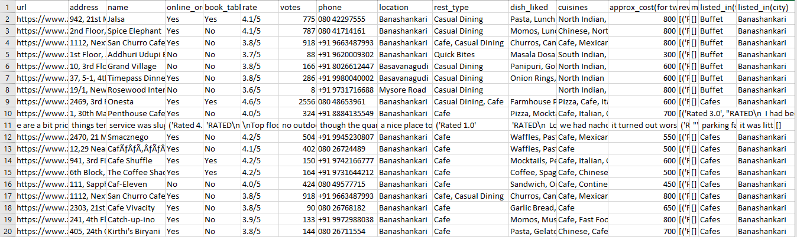
Data Sample
Votes : Average votes have been used as a metric for Reliability of restaurants
Rate: Rate represents average rating . Of each restaurant which has been used as a metric for Quality .
Approx_cost: Average approximate cost for 2 people have been chosen as a metric for Affordability.

Slide 3
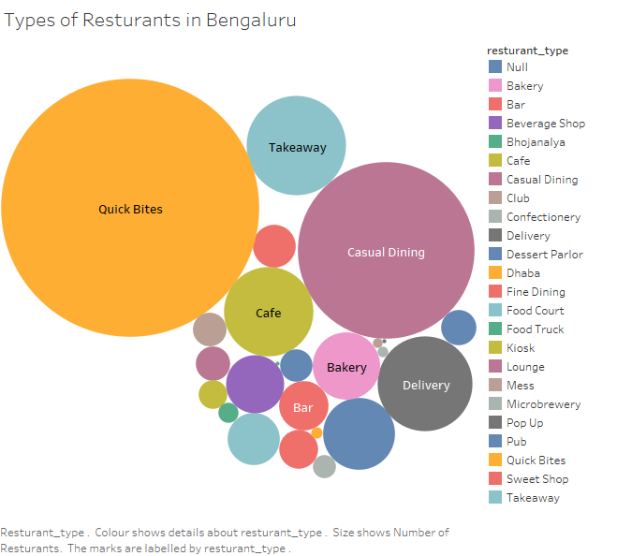

Slide 4
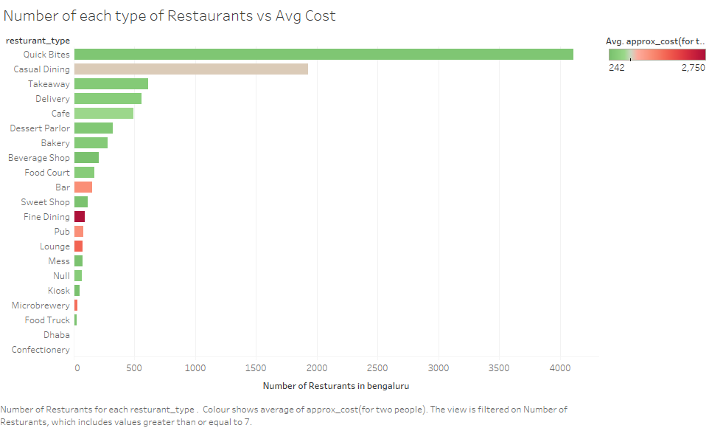

Slide 5
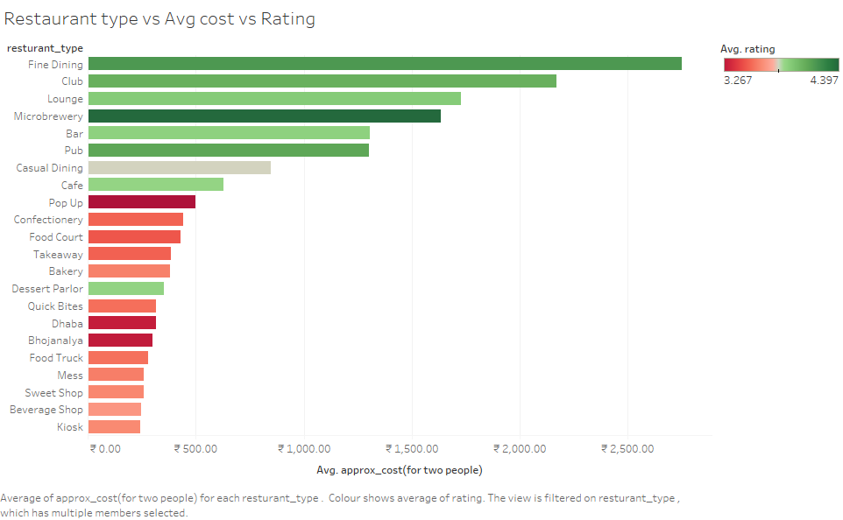
We can clearly see the trend of a decreasing average rating with a decrease in average cost.

Slide 6
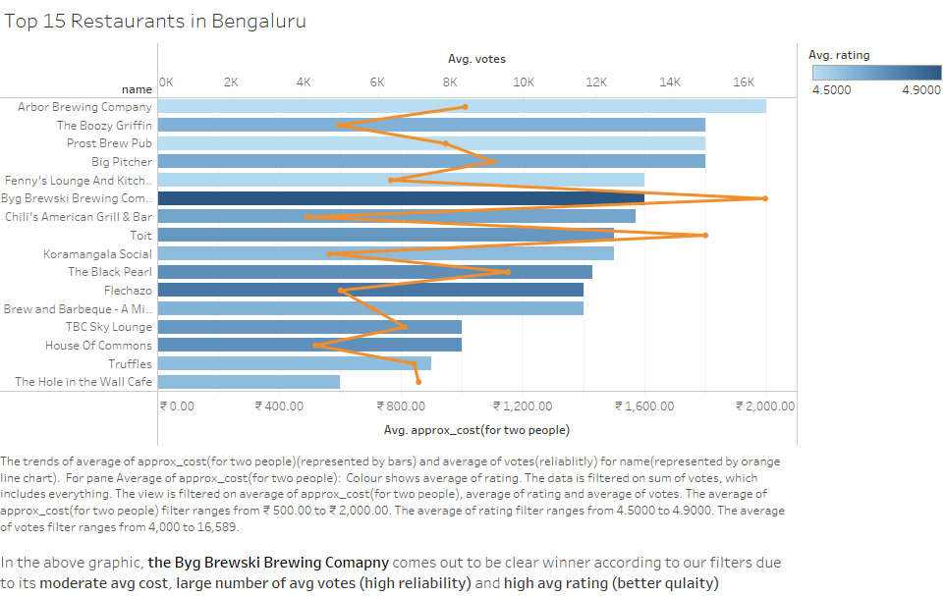

Slide 7
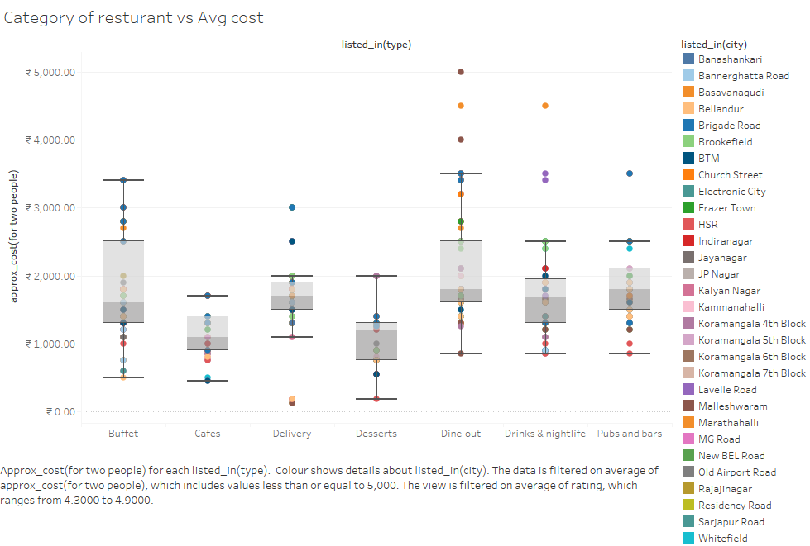

Slide 8
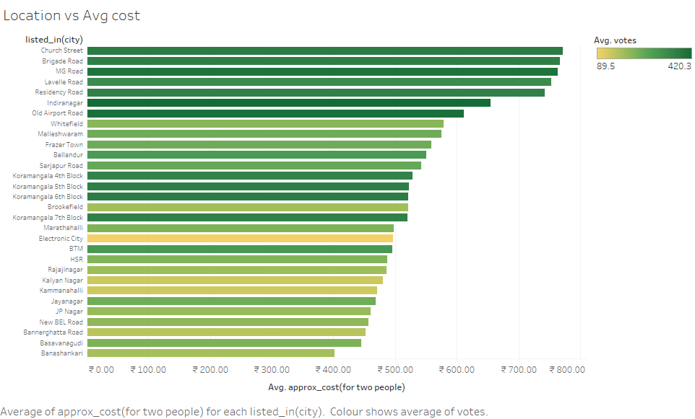

Slide 9
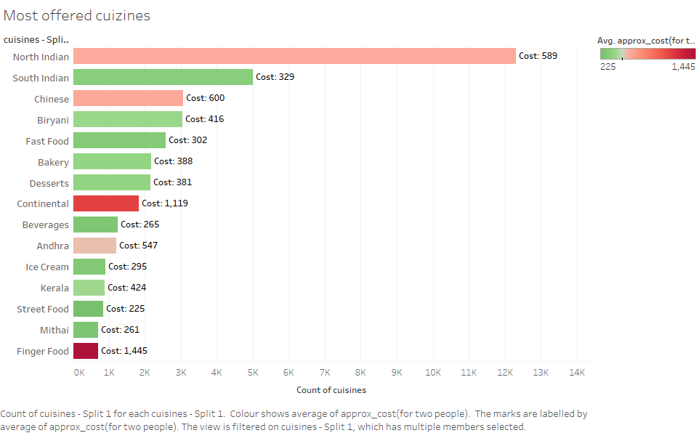

Slide 10
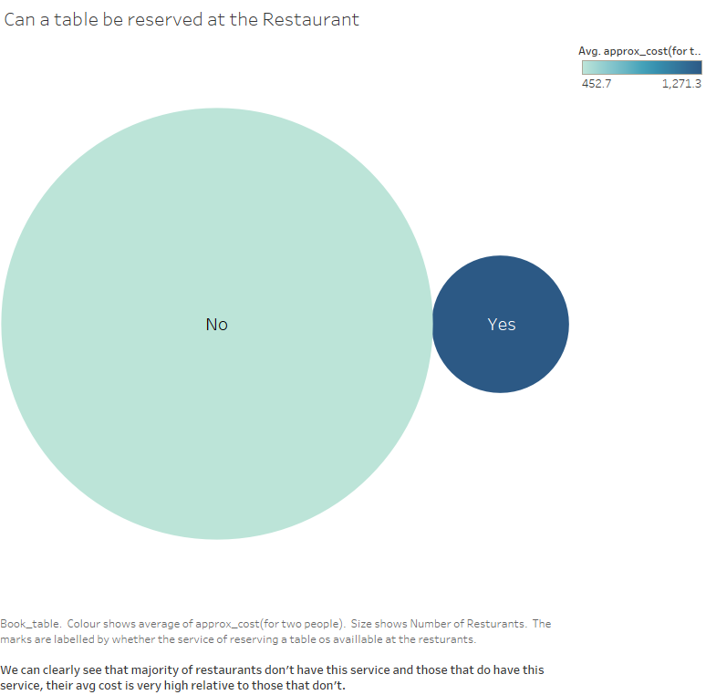

Slide 11
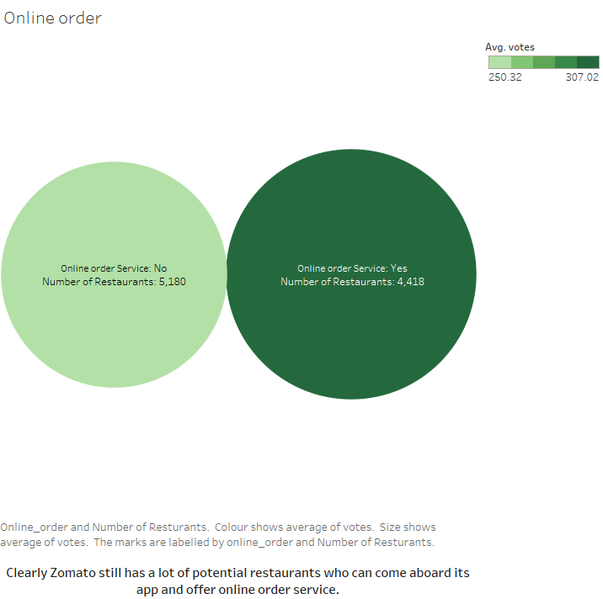

Slide 12
Thank you

